Slide 1
Setup a new measuring instance

Slide 2
Bill of Material
Pi 5 with at least 4GB RAM
NVME Extension and minimum 128GB SSD
abaton clima measurement system PCB [short: ACMS]
Network Cable RJ45
Digisense
Mux PCB
2 x Scale Duett 8kg
9V PSU
6 x ENS 210
4 x DS18B20 (PT1000)
2 x Hailege MLC90614 IR Cam
Webcam with USB
2 x flow measurement unit

Slide 3
Setting up the new pi
take a new pi and generate an image for a pi5 with some settings:
username: rabaton
password: lack..
wifi: rudi // bbaton125!
enable ssh
first time boot use an external monitor and obtain the IP address of the device
enable under preferences -> raspberry configuration
onewire
I2C
SPI
then reboot. afterwards -> Accessoires -> SD Card Copier
copy content of SD card onto SSD (new UUID Partitions must be checked)
open sudo nano /boot/firmware/config.txt and add the line: dtparam=pciex1
power off, remove SD card, power on
register the pi with our raspberry cloud:
sudo apt update
sudo apt upgrade
click icon right top on the desktop with the two squares and the circles and use
beschaffung@abaton.studio
rasART135!
ssh key für ds_readout git raphael geben
ssh-keygen -t rsa
den public key ins gitHub kopieren als deploy key
git clone https://github.com/xtlc/ds_readout.git machen am pi
cd ds_readout
python -m venv venv
source venv/bin/activate
python -m pip install -r req
Create an empty env file nano .env, save with CRTL + O and [y]

Slide 4
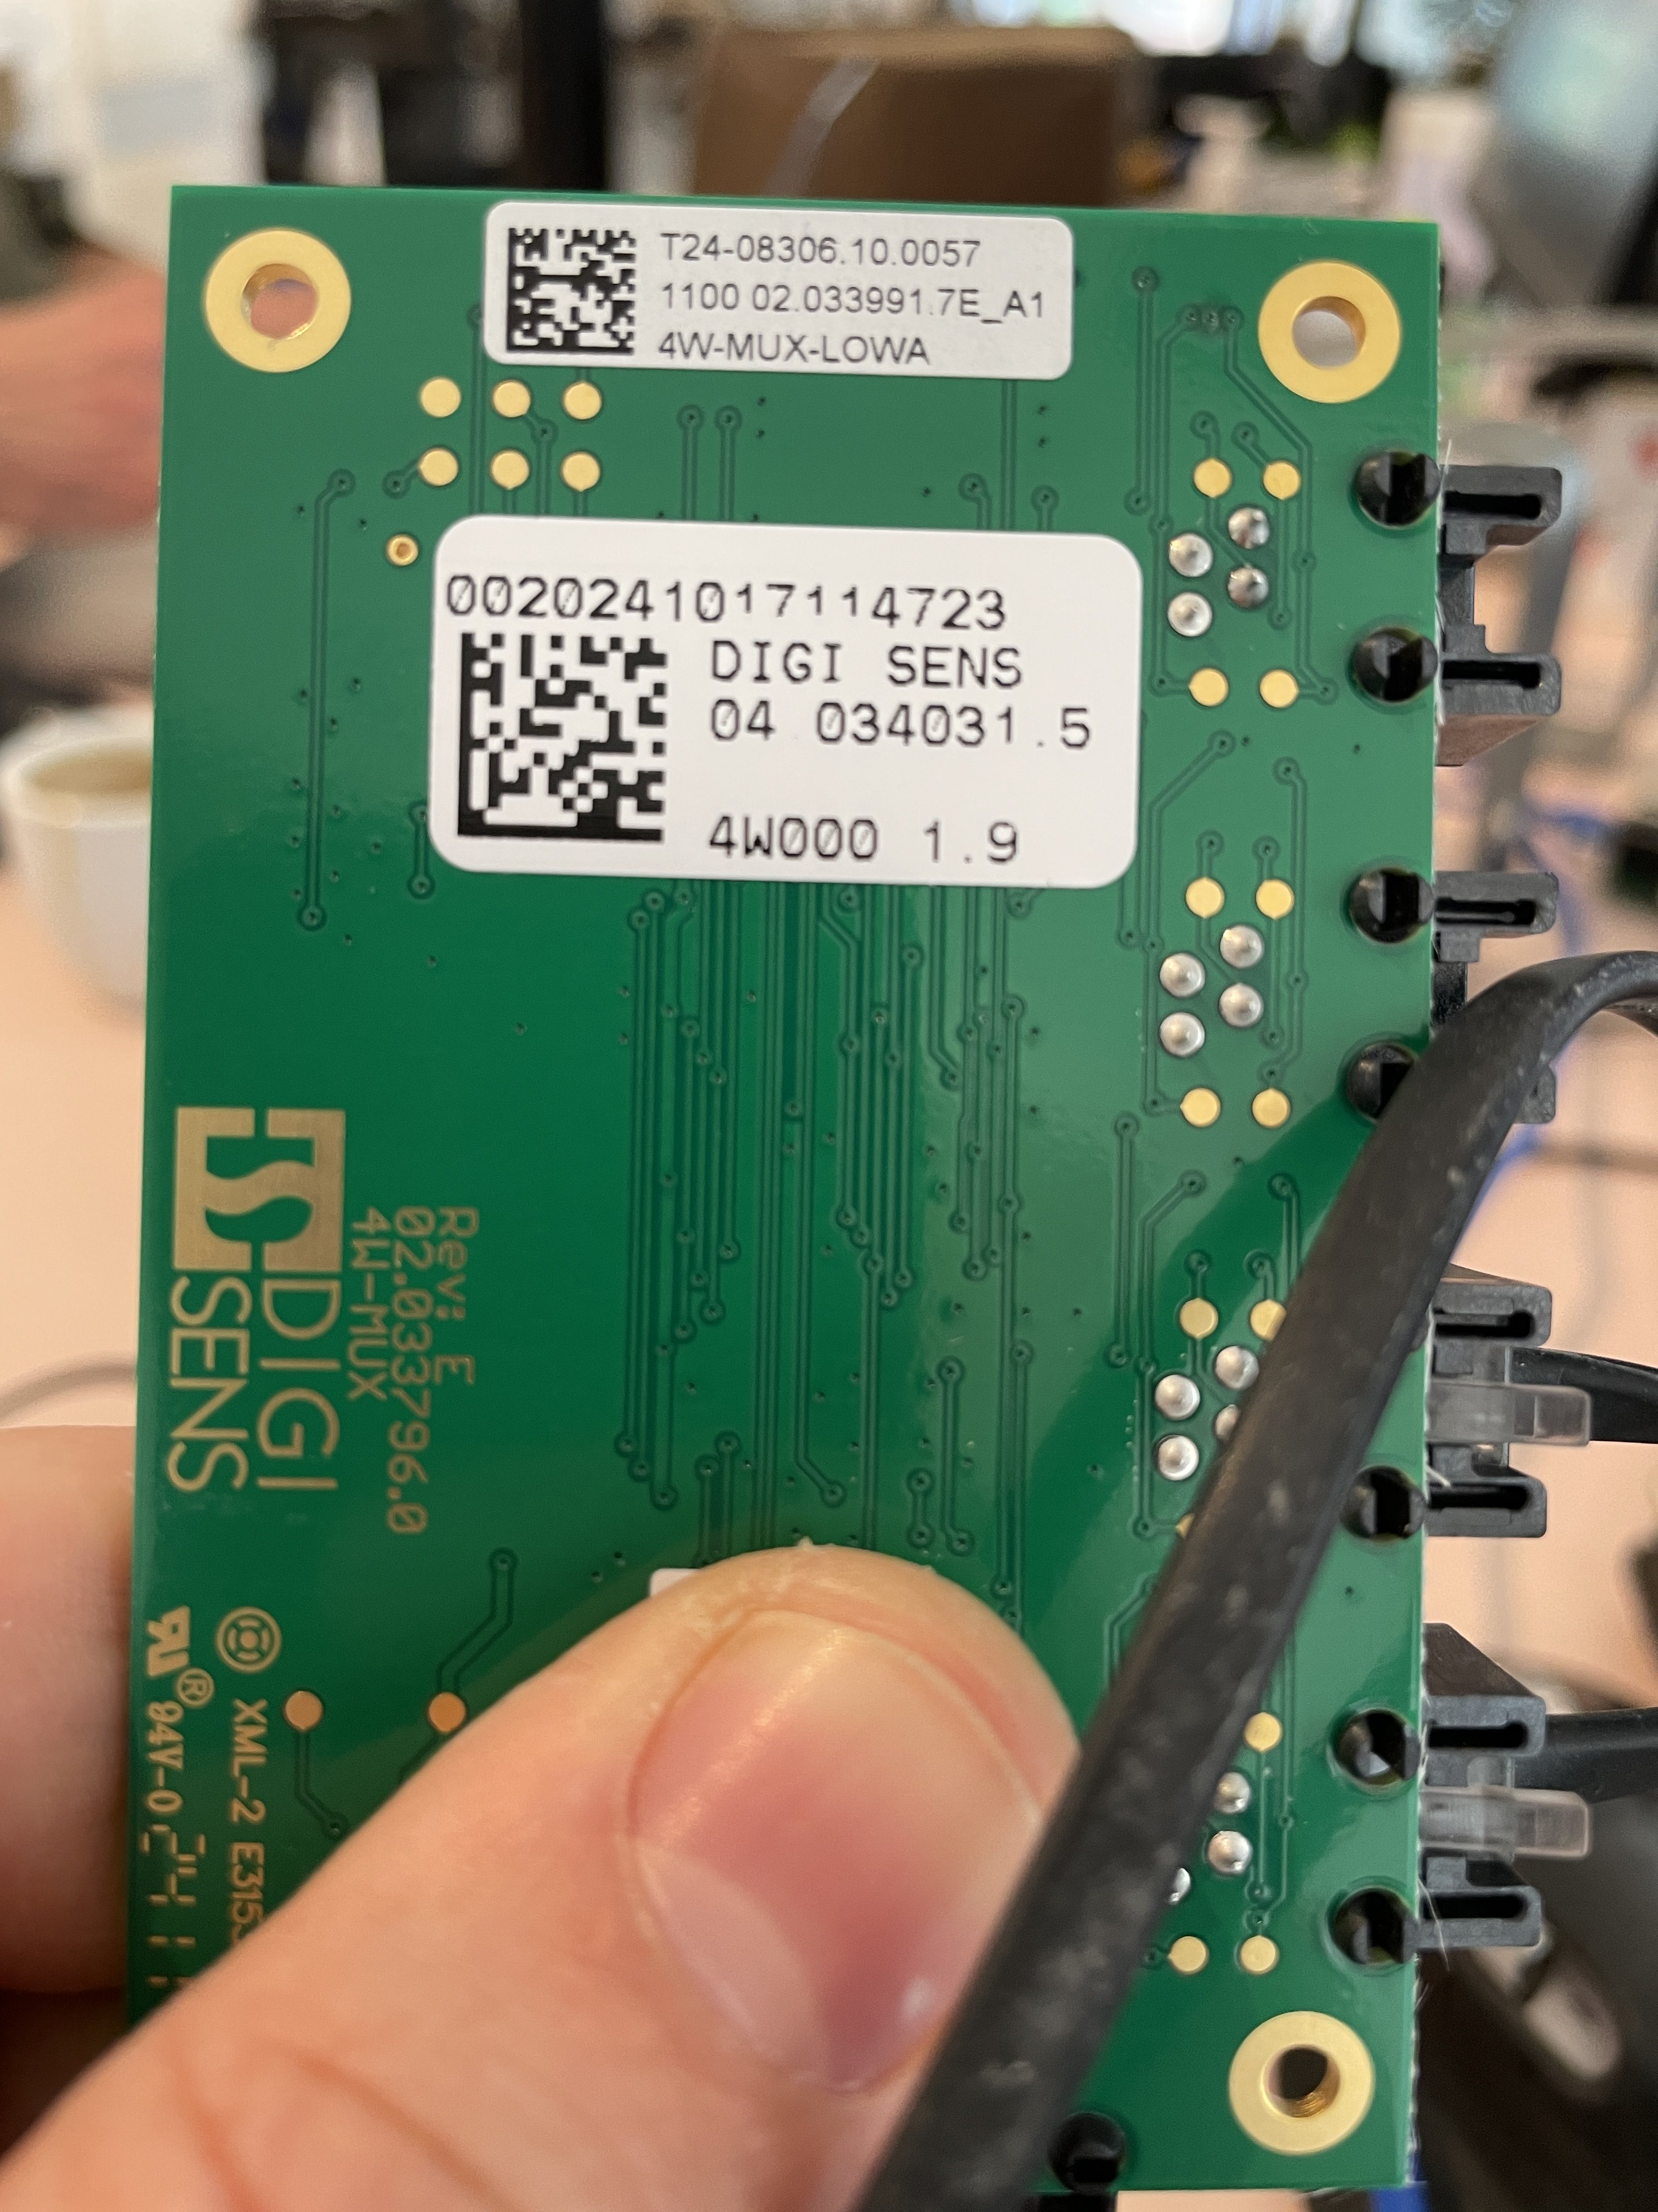
Setting up the scales
Connect MUX to ACMS using a RJ45 cable
Plug 9V power supply into ACMS
Take Sticker from MUX plate and use number
write number into the .env file:
MUX=0020241017114723

